Slide 1
Paid Media Data Analysis
Overview of marketing channel performance across the customer journey.

Slide 2
Analyzes Content
Paid Media Concepts
Summary
1. Funnel Stages by Month
2. Funnel Stages by Segments
3. Funnel Stage by Channel
4. Hand raisers by MQLs Channel
5. Funnel Stages Conversations Rate by Channel
6. Funnel Stage Costs by Channel
7. Most Effective Campaigns
8. Pipeline Spend Ratio by Channel
9. ROI by Channel
- Additional Analysis: 10. Average Deal Size by Channel
*Data provided in document

Slide 3
Paid Media Concepts
Funnel Stages
Leads
Opportunities
Potential customers with initial interest.
Leads in active sales process.
MQLs (Marketing Qualified Leads)
Closed Won Bookings
Leads assessed by marketing, ready for sales.
Final phase: Sale completed. won booking for each channel
Channels
Paid Social
Paid Displayed
Paid Search
Content Syndication
Remarking
Paid ads on social media platforms.
Paid ads on websites and networks.
Paid ads on search engines.
Republishing content on other sites.
Reengage users who have visited your site.

Slide 4
Analysis Summary
Channels Efficiency Overview
Paid Search: Highest ROI with a notable Pipeline Spend Ratio of 180. Leads funnel performance with a 97% hand-raiser rate.
Content Syndication: Best at conversion with a 25% Pipeline to Booking rate.
Paid Social: Requires investment review due to the highest cost but increasing conversion trend.
Paid Displayed: Most economical with lowest total cost, strategic adjustments needed for Leads to MQLs risk.
Segment:
SMB: Promising with a 12% rate in Pipeline Opportunities. Small and medium businesses could yield better outcomes despite representing a smaller portion of data.
Campaign Performance:
Customer Engagement Campaign Top in generating Leads (33).
Email Marketing Platform Top in generation MQLs (8).
Brand Campaign Top in generating Pipeline Opportunities (3).
Conclusion: Paid Search stands out as the most strategic channel for resource allocation and investment, due to its high return and efficient cost distribution across funnel stages.
*Data provided in document

Slide 5
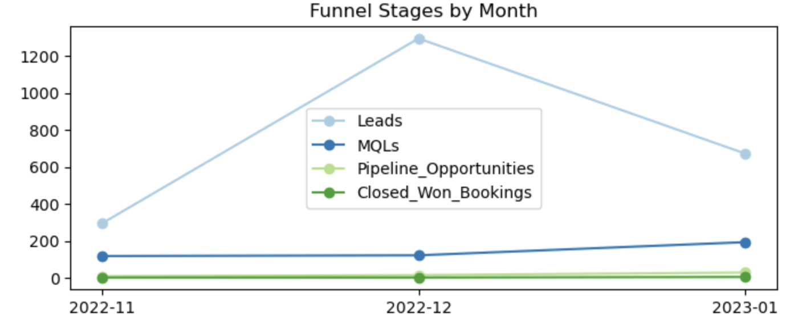
1. Funnel Stages by Months
Month | Leads | MQLs | Pipeline Opportunities | Closed Won Bookings | Total
2022-11 | 296 (70%) | 118 (28%) | 9 (2%) | 2 (0.4%) | 425
2022-12 | 1294 (90%) | 122 (9%) | 15 (1%) | 2 (0.1%) | 1433
2023-01 | 672 (75%) | 193 (21%) | 29 (3%) | 5 (0.5%) | 899
Total | 2262 | 433 | 53 | 9 | 2757
* There was an entry dated Dec/2023 in the Pipeline Opportunities, which was omitted from the analysis.
Nov/2022 had a better conversion rate for Closed Won Bookings, though the absolute number was just 2.
Dec/22, had the highest lead volume as observed through the graphic, but the lowest conversion rate in Closed Won Bookings at only 0.1%.
Jan/2023 was the most successful month, achieving a higher conversion rate of 0.5% in Closed Won Bookings, more than double that of November 2022, despite fewer leads."
*Data provided in document

Slide 6
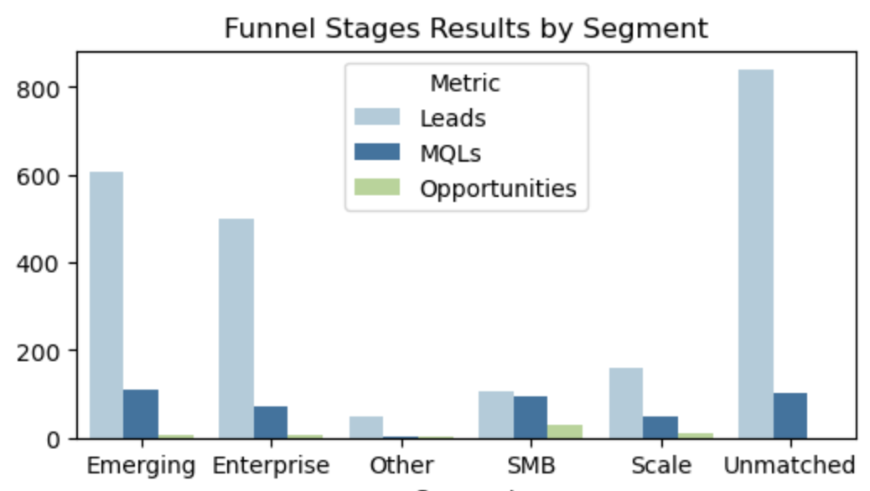
2. Funnel Stages Results by Segment
Segment | Leads | MQLs | Pipeline Opportunities | Total
Unmatched | 841 | 104 | 0 (0%) | 945
Emerging | 606 | 109 | 8 (1%) | 723
Enterprise | 500 | 73 | 8 (1%) | 581
SMB | 106 | 94 | 28 (12%) | 228
Scale | 161 | 49 | 9 (4%) | 219
Other | 48 | 4 | 1 (2%) | 53
2749
34% of the data is not categorized into any segment (unmatched), which could affect the analysis due to these uncategorized entries.
Emerging (large companies with significant decision-making complexities) is the segment that had the highest volume but only a 1% rate in Pipeline Opportunities.
SMB (small and medium-sized companies) segment though having fewer data entries, showed a much higher rate in Pipeline Opportunities at 12%. Therefore, small and medium businesses yield better outcomes.
Scale (companies in phase of accelerated growth) despite their lower volume, had a 4% conversion rate, the second-highest following after SMB.
*Data provided in document

Slide 7
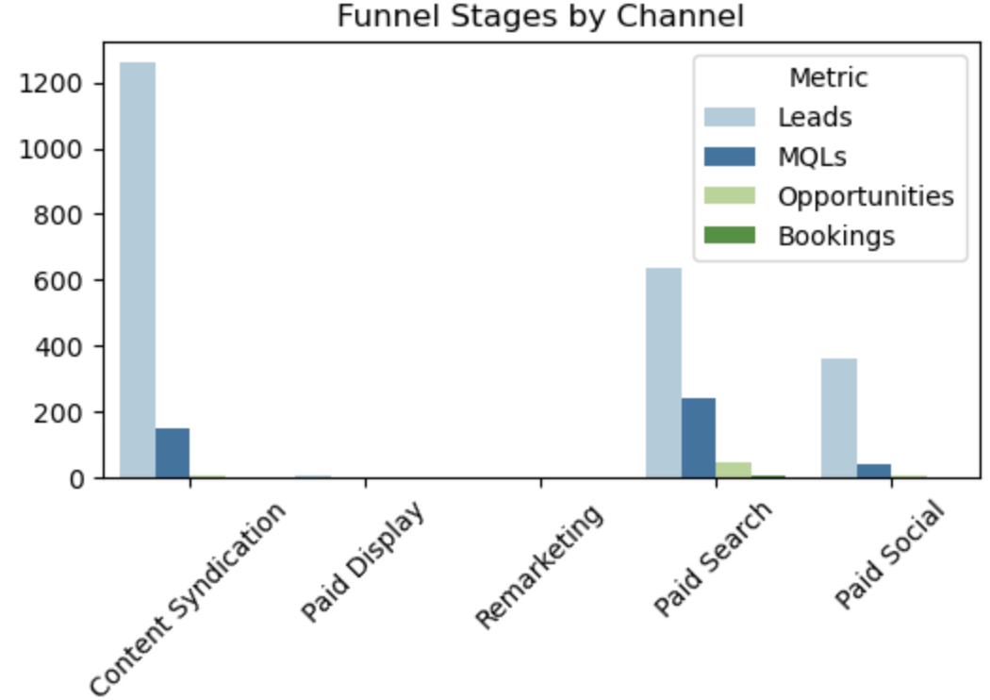
3. Funnel Stages by Channel
Channel | Leads | MQLs | Pipeline Opportunities | Bookings | Total
Content Syndication | 1260 (89%) | 150 (10%) | 4 (0.3%) | 1 (0.1%) | 1415
Paid Search | 635 (68%) | 243 (26%) | 44 (5%) | 7 (0.8%) | 929
Paid Social | 361 (89%) | 39 (10%) | 6 (2%) | 1 (0.2%) | 407
Paid Displayed | 5 (83%) | 1 | 0 | 0 | 6
Remarking | 1 | 0 | 0 | 0 | 1
- Paid Search demonstrates a more consistent funnel, resulting in Bookings at a rate of 0.8%
- Paid Social shows a sharp decline, dropping from 89% of Leads to just 10% of MQLs, yet still achieves a Booking conversion of 0.2%.
In summary, Paid Search appears to be the channel with the best performance.
*Data provided in document

Slide 8
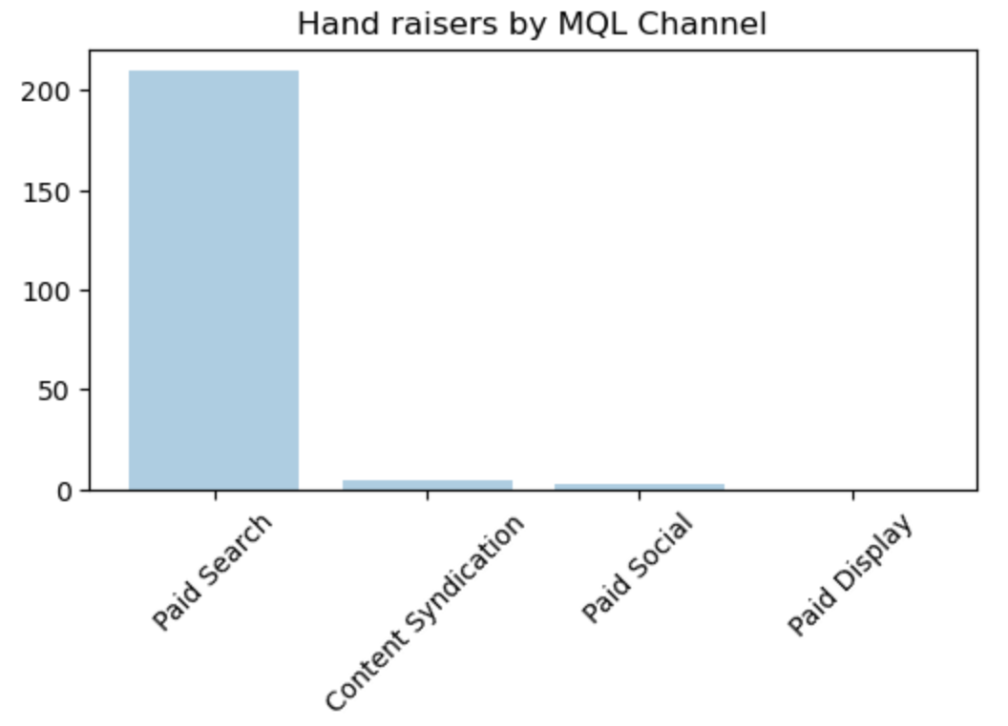
4. Hand raisers by MQL Channels
Channel | Hand raisers
Paid Search | 210 (97%)
Content Syndication | 4 (2%)
Paid Social | 3 (1%)
Paid Displayed | 0 (0%)
Paid Search has 97% of hand raisers, making it the leading channel in this regard.
This channel might have have the potential to significantly improve conversation rates.
*Data provided in document

Slide 9
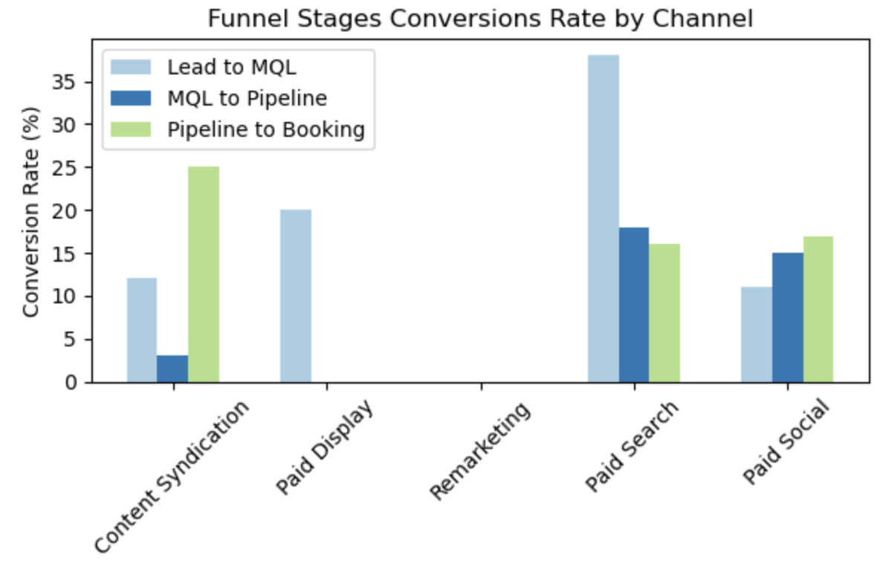
5. Funnel Stages Conversions Rate by Channel
Channel | Lead to MQL | MQL Pipeline | Pipeline to Booking
Content Syndication | 12% | 3% | 25%
Paid Social | 11% | 15% | 17%
Paid Search | 38% | 18% | 16%
Paid Displayed | 20% | 0% | 0%
Remarketing | 0% | 0% | 0%
Paid Search leads in terms of Lead to MQL conversion, and MQL to Pipeline conversion.
However, for Pipeline to Booking conversion, Content Syndication is the most effective with 25%, followed by Paid Social at 17% and Paid Search at 16%.
Although Content Syndication leads in Pipeline to Booking, an analysis of the graph suggests that Paid Social might be the most efficient channel.
This is because conversions in this channel are on the rise, in contrast to Paid Search, which shows a decreasing trend in conversions.
*Data provided in document

Slide 10
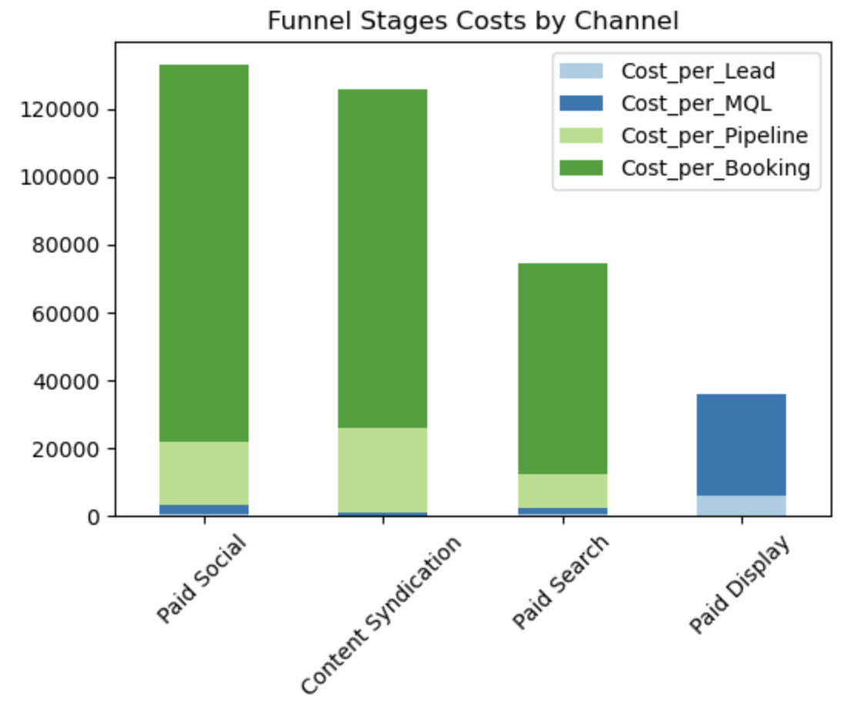
6. Funnel Stages Costs by Channel
Channel | Cost per Lead | Cost per MQL | Cost per Pipeline | Cost per Booking | Total
Paid Social | 308 | 2,855 | 18,558 | 111,349 | 133,07 (36%)
Content Syndication | 79 | 666 | 25,000 | 100,000 | 125,745 (34%)
Paid Search | 685 | 1,790 | 9,886 | 62,141 (83%) | 74,502 (20%)
Paid Displayed | 6,000 | 30,000 | 0 | 0 | 36,000
Total | 7,072 | 35,311 | 53,444 | 273,490 | 369,317
Paid Social is the most costly channel, with 36% of the total cost, followed by Content Syndication with 34%. Both show low costs for Lead and MQL, but high for Pipeline and Booking.
Paid Search has 20% of the total cost and shows a gradual increase in cost across stages, yet it’s still cheaper than Paid Social and Content Syndication.
Paid Displayed has the highest cost for Lead and MQL, but none for Pipeline and Booking, making it the channel with the lowest total cost, at only 10%. Although Paid Displayed has the lowest cost, it might be the riskiest due to the high investment in Leads and MQLs.
Therefore, Paid Search seems to be the best channel, as it has progressively increasing costs and 83% of the total is in the final Booking stage.
*Data provided in document

Slide 11
7. Most Effective Campaigns
fy23-q4-amer-customer_engagement_review_canada | Leads: This campaign generated 33 new leads, the most out of all campaigns
fy22-amer-email_marketing_platform | MQLs: This campaign generated 8 new MQLs, the highest of all campaigns
fy22-amer-brand_l_brand | Pipeline Opportunities: This campaign generated 3 new opportunities, the most among all campaigns
These were the top 3 campaigns in generating Leads, MQLs and Opportunities

Slide 12
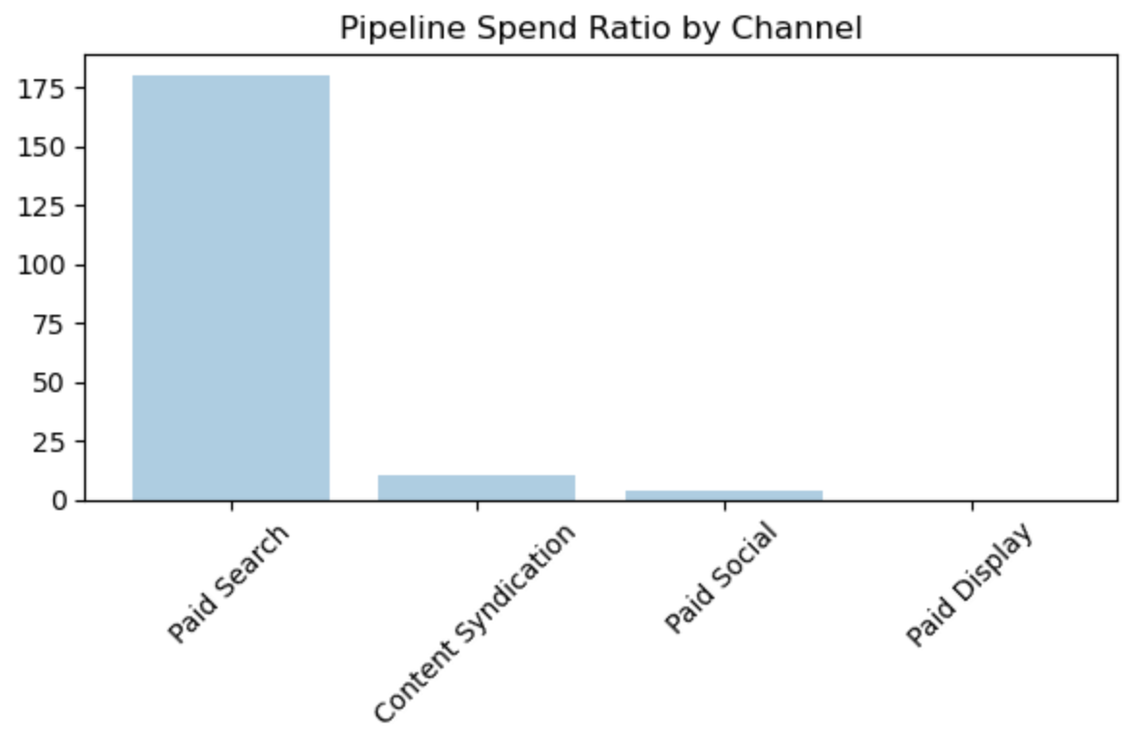
8. Pipeline Spend Ratio by Channel
Channel | Pipeline Amount | Spend | Pipeline Spend Ratio
Paid Search | 78.343.625 | 435.000 | 180
Content Syndication | 1.039.082 | 100.000 | 10
Paid Social | 438.704 | 111.349 | 4
Paid Display | 0 | 30.000 | 0
Paid Search is the channel with the highest spend, totaling 435 thousand, and it also has the highest Pipeline value, reaching 78 million.
Consequently, its Pipeline Spend Ratio stands at 180, the highest among all channels, signifying its efficiency in generating sales opportunities in proportion to the investments made.
*Data provided in document

Slide 13
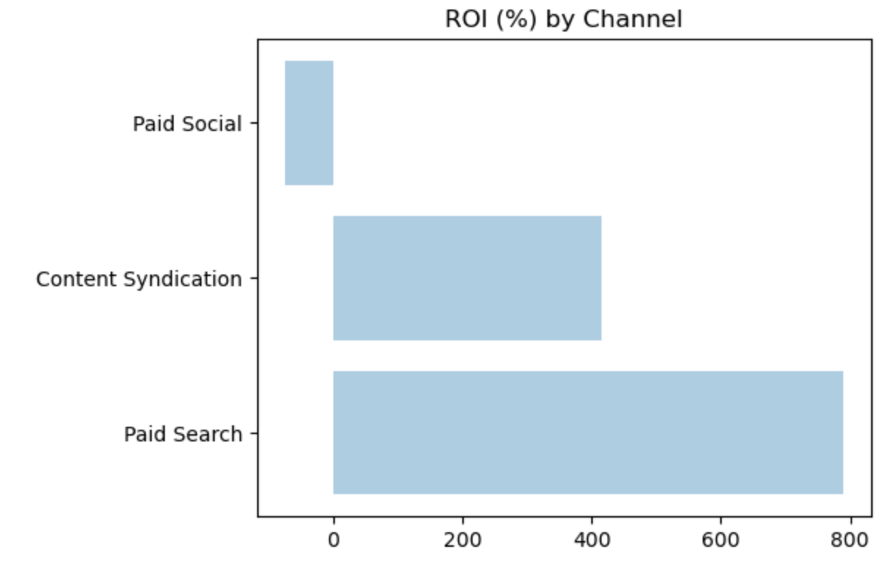
9. ROI (%) by Channel
Channel | ROI %
Paid Social | -75.0
Content Syndication | 415.0
Paid Search | 789.3
Paid Search is the channel with the highest ROI (789), followed by Content Syndication (415). On the other hand, Paid Social has a negative ROI (-75).
In Summary, Paid Search is the best channel for investment, bringing high returns.
Paid Social demands analysis and some strategic change to transform its negative ROI into a positive and profitable outcome.
*Data provided in document

Slide 14
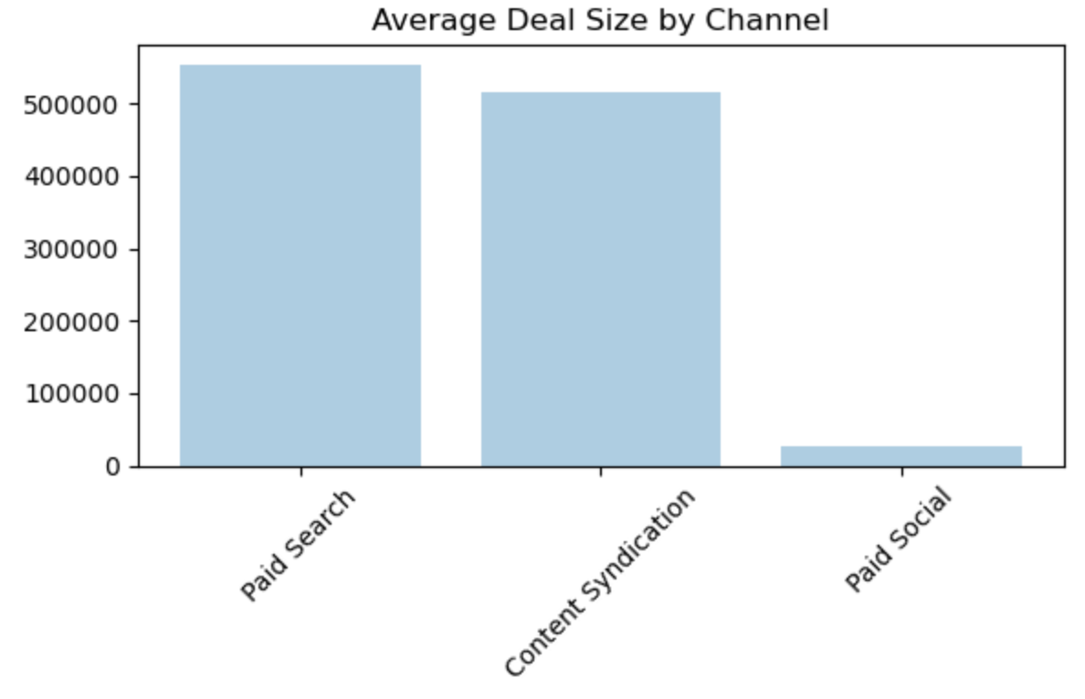
10. Average Deal Size by Channel
Channel | Avg Deal Size
Paid Search | 552.634
Content Syndication | 515.000
Paid Social | 27.842
Paid Search is the channel that brings larger deals, followed by Content Syndication.
This analysis was calculated by the average value of Closed Won Bookings for each channel, and this can guide strategies about where to allocate resources for maximum revenue impact.
*Data provided in document

